Slide 1

Security: Attack and Defense
Computer System Principles, Fall 2020 (IPADS, SJTU)
From system's perspective
Yubin Xia

Slide 2


Control-Flow Attack

Slide 3
Review: ROP Attacks
ROP: Return-oriented Programming
  Find code gadgets in existed code base
    Usually 1-3 instructions, ends with 'ret'
    In libc and application, intended and unintended
  Push address of gadgets on the stack
  Leverage 'ret' at the end of gadget to
  connect each code gadgets
  No code injection
0101011010
0101011010
0101011010
return addr
0101011010
saved ebp
0101011010
0101011010
0101011010

Slide 4
Code Execution – The ROP Way
Mem[v2] = v1
a₃
v₂
a₂
v₁
Desired Logic
Stack
mov %eax v1;
mov %ebx v2;
mov [%ebx], %eax
a₁: pop eax; ret
a₂: pop ebx; ret
a₃: mov [ebx], eax

Slide 5
Code Execution – ROP Way
a₃
v₂
a₂
v₁
a₁
…
argv
argc
return addr
caller's ebp
buf (64 bytes)
argv[1]
buf
Mem[v2] = v1
Desired Shellcode
%ebp
a₁: pop eax; ret
a₂: pop ebx; ret
a₃: mov [ebx], eax
Desired store executed!
%esp

Slide 6
Defense
Hide the binary file
  No way to get any gadget
ASLR to randomize the code position
  Short for "Address Space Layout Randomization"
  Harder to find gadgets
Canary to protect the stack
  Try to detect stack overflow (e.g., overflow return address)

Slide 7
ASLR
Change the layout of memory space
Every time when a process is created
  Question: how about create by fork?
User-level as well as kernel-level

Slide 8

Canary
Stack
Embed "canaries" in stack frames and verify their integrity prior to function return
  Canary is just a random number
  Check canary before return, alert if not equal
StackGuard implemented as a GCC patch
  Program must be recompiled
  Performance overhead: 8% for Apache
Return Addr
Canary

Slide 9
CFI: Control Flow Integrity

Slide 10
CFI: Control-Flow Integrity
Main idea: pre-determine control flow graph (CFG) of an application
  Static analysis of source code
  Static binary analysis ← CFI
  Execution profiling
  Explicit specification of security policy
Execution must follow the pre-determined control flow graph

Slide 11
CFI Idea
+
=
Executable
Control-Flow Graph
Self-checking program
Notes:
The idea of CFI is very simple: embed a simple security policy within the executable itself, in the form of a control-flow graph. The executable itself will monitor its execution, and any attempt to deviate from the prescribed CFG will result in an error. Thus, if a virus attempts to step outside the prescribed CFG, it will shut down the program.

Slide 12
CFI: Binary Instrumentation
Use binary rewriting to instrument code with runtime checks
Inserted checks ensure that the execution always stays within the statically determined CFG
Whenever an instruction transfers control, destination must be valid according to the CFG
Goal: Secure even if the attacker has complete control over the thread's address space

Slide 13
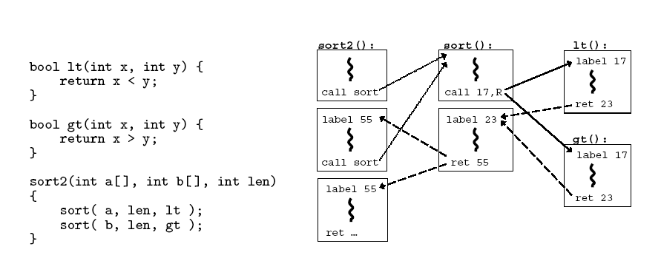
CFG Example

Slide 14
CFI: Control Flow Enforcement
For each control transfer, determine statically its possible destination(s)
Insert a unique bit pattern at every destination
  Two destinations are equivalent if CFG contains edges to each from the same source
    This is imprecise (why?)
  Use same bit pattern for equivalent destinations

Slide 15
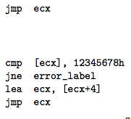
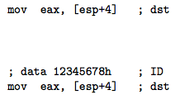
CFI: Example of Instrumentation
Original
Patched

Slide 16
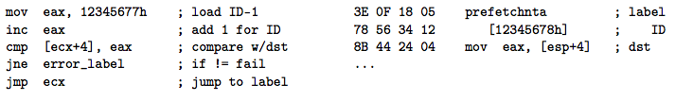
CFI: Example of Instrumentation
Prefetchnta: prefetch memory to cache. Become a nop if not available.

Slide 17
CFI: Preventing Circumvention
Unique IDs
  Bit patterns chosen as destination IDs must not appear anywhere else in the code memory except ID checks
Non-writable code
  Program should not modify code memory at runtime
    What about run-time code generation and self-modification?
Non-executable data
  Program should not execute data as if it were code
Enforcement: hardware support + prohibit system calls that change protection state + verification at load-time

Slide 18
Improving CFI Precision
Suppose a call from A goes to C, and a call from B goes to either C, or D (when can this happen?)
  CFI will use the same tag for C and D, but this allows an "invalid" call from A to D
  Possible solution: duplicate code or inline
  Possible solution: multiple tags

Slide 19
Improving CFI Precision
Function F is called first from A, then from B; what's a valid destination for its return?
  CFI will use the same tag for both call sites, but this allows F to return to B after being called from A
  Solution: shadow call stack
    Maintain another stack, just for return address
    Intel CET to the rescue (not available yet)

Slide 20
CFI: Security Guarantees
Effective against attacks based on illegitimate control-flow transfer
  Stack-based buffer overflow, return-to-libc exploits, pointer subterfuge
Does not protect against attacks that do not violate the program's original CFG
  Incorrect arguments to system calls
  Substitution of file names
  Other data-only attacks

Slide 21
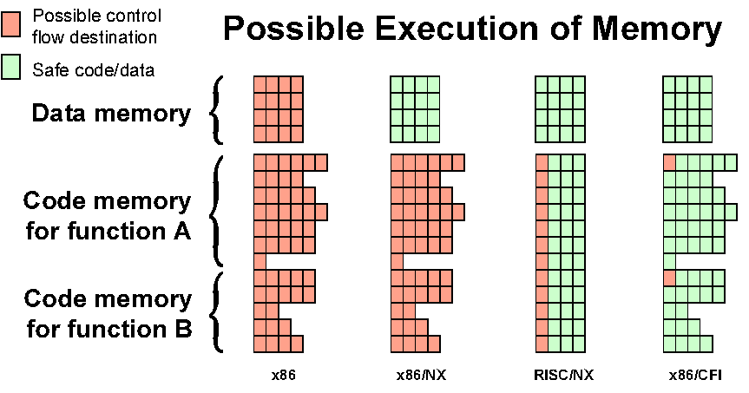
Possible Execution of Memory
[Erlingsson]

Slide 22
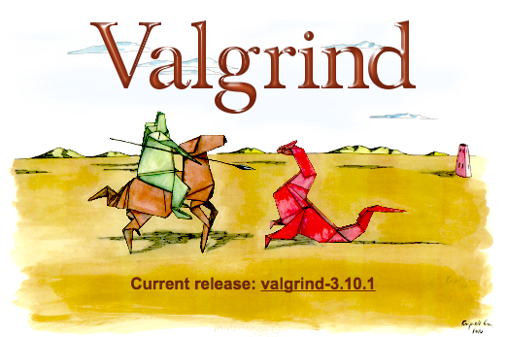
TaintCheck
Dynamic taint analysis for automatic detection, analysis, and signature generation of exploits on commodity software, NDSS’05

Slide 23
TaintCheck: Basic Ideas
Program execution normally derived from trusted sources, not attacker input
Mark all input data to the computer as "tainted" (e.g., network, stdin, etc.)
Monitor program execution and track how tainted data propagates (follow bytes, arithmetic operations, jump addresses, etc.)
Detect when tainted data is used in dangerous ways

Slide 24
Add Taint Checking code
TaintCheck first runs the code through an emulation environment (Valgrind) and adds instructions to monitor tainted memory
X86 instructions
UCode
Binary re-writer
Taint Check
X86 instructions
UCode
Dynamic taint analysis

Slide 25
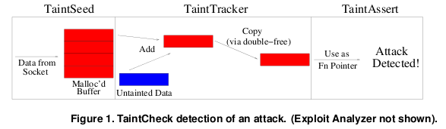
TaintCheck Detection Modules
TaintSeed: Mark untrusted data as tainted
TaintTracker: Track each instruction, determine if result is tainted
TaintAssert: Check is tainted data is used dangerously

Slide 26
TaintSeed
Marks any data from untrusted sources as "tainted"
  Each byte of memory has a four-byte shadow memory (!) that stores a pointer to a Taint data structure if that location is tainted
  Else store a NULL pointer

Slide 27
TaintTracker
Tracks each instruction that manipulates data in order to determine whether the result is tainted
  When the result of an instruction is tainted by one of the operands, TaintTracker sets the shadow memory of the result to point to the same Taint data structure as the tainted operand

Slide 28
TaintCheck Detection Modules
TaintAssert
  Jump addresses: function pointers or offsets
  Format strings: is tainted data used as a format string arg?
  System call arguments
  Application or library customized checks

Slide 29
When does TaintCheck Give a False Positive?
TaintCheck detects that tainted data is being used in an illegitimate way even when there is no attack taking place. Possibilities:
  There are vulnerabilities in the program and need to be fixed, or
  The program performs sanity checks before using the data

Slide 30
Performance Evaluation – CPU Bound Process
Hardware: 2.00 GHz Pentium 4, 512 MB RAM, RedHat 8.0
Application: bzip2(15mb)
  Normal runtime 8.2s
  Valgrind nullgrind skin runtime: 25.6s (3.1x)
  Memcheck runtime: 109s (13.3x)
  TaintCheck runtime: 305s (37.2x)

Slide 31
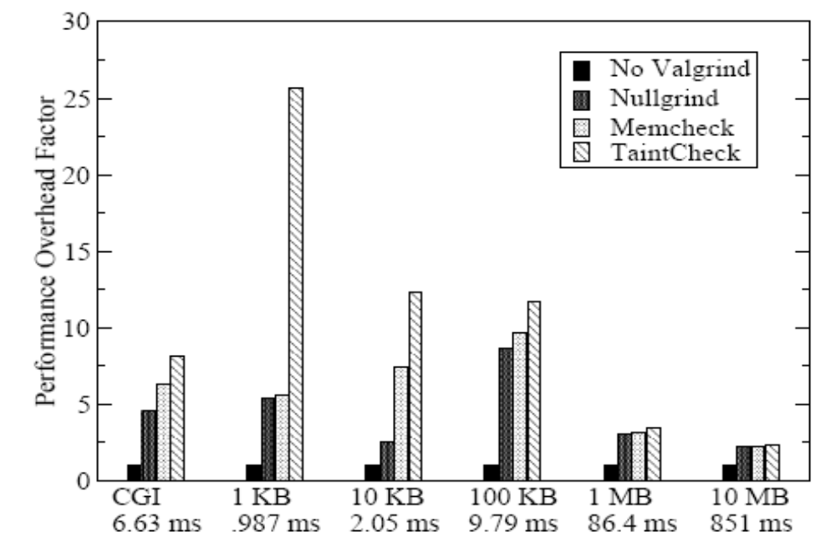
Performance Overhead of Apache
A more representative case, network and I/O

Slide 32
TaintDroid
Only incur 14% overhead!

Slide 33
Android Background Information
Applications written in Java
  Java Native Interface (JNI)
  Compiled into Dalvik Executable (DEX) byte-code format
  Executes within Dalvik VM interpreter instance
    Register-based as opposed to stack-based
    Runs isolated on the platform
      Has unique UNIX user identities
  Components communicate via binder IPC mechanism

Slide 34
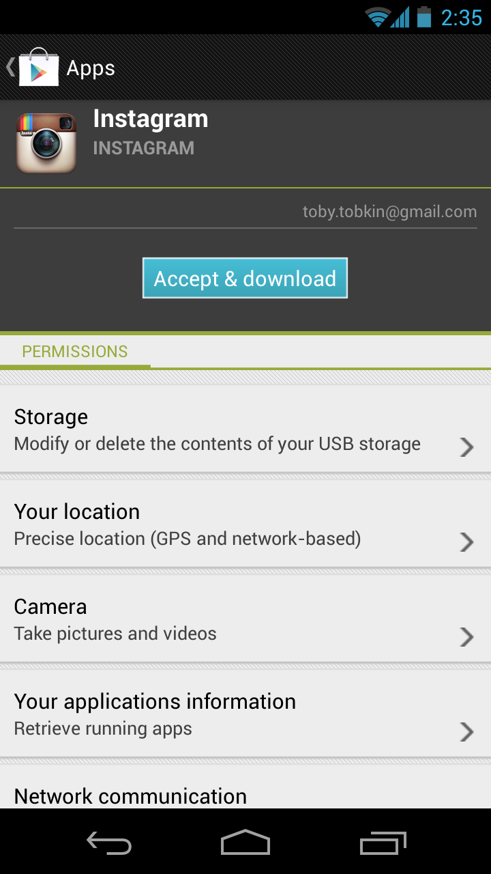
Motivation
Historical problem with computer software: privacy violations
  Unwitting users
Problem exacerbated by smartphones
  Almost ubiquitously store private information
  Large array of sensors
  Monetization pressures to detriment of user privacy
  Cited by paper: [12, 19, 35]
Android’s coarse-grained privacy control
Notes:
Almost ubiquitously store: I’m sure you’re all aware, but cellular phones tend to contain data such as contacts, account information, and lascivious images.
Large array: GPS, accelerometers, cameras, microphones
Monetization: Security is, intrinsically, a secondary concern in most situations, and mobile application distribution is certainly such a situation. The foremost goal of the App Store or the Play Store is to sell applications, and placing more cumbersome security requirements on their distribution is obviously at odds with this.
Incidents of problems exacerbated by smartphones: [35, 12] & [19]

Slide 35
Motivation
Current privacy control methods arguably inadequate
Idea:
  Can’t change the current system without repercussions
  Instead, create a method to audit untrusted applications
Execution:
  Must be able to detect potential misuses of private information,
  And be fast enough to be usable
Android’s coarse-grained privacy control
Notes:
Idea: Since the phrase goes, "Money talks" and not "security talks," obviously a smart solution is to have some workaround method of determining whether user privacy is being respected or not.

Slide 36
Taint Sources & Sink
Device identifiers
  IMEI
Network taint sink
  WiFi
  3G
  SMS
Low-bandwidth sensors
  Location, accelerometer
High-bandwidth sensors
  Microphone, camera
Information database
  Address book, SMS, phone call log, etc.

Slide 37
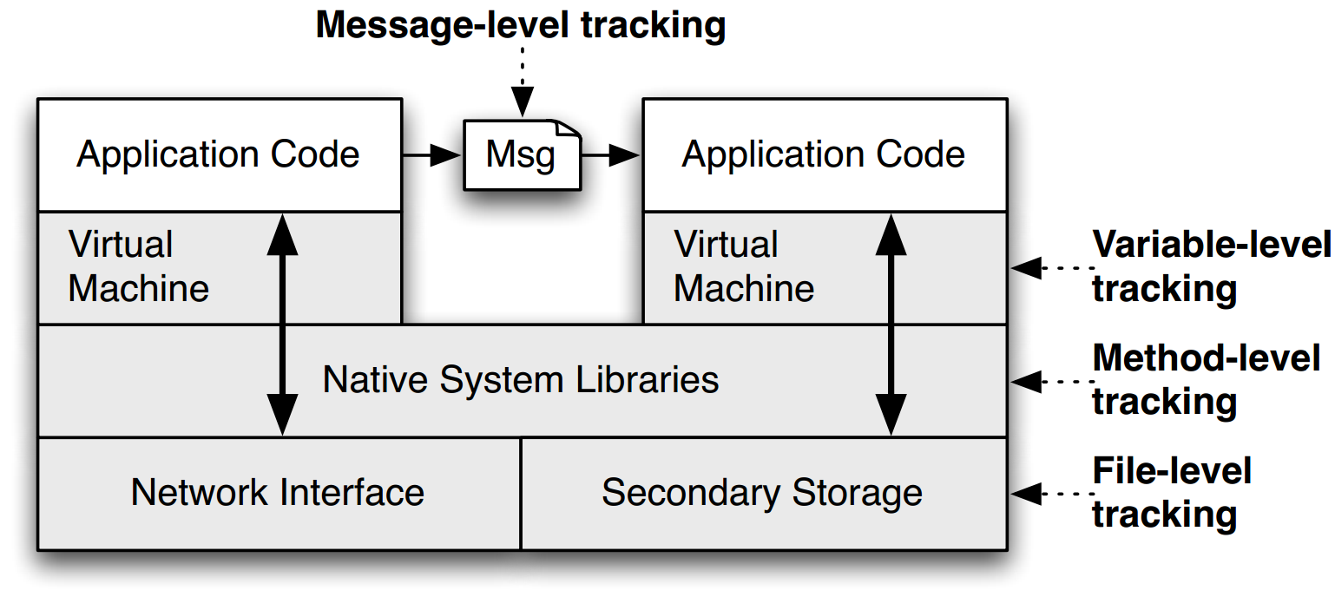
TaintDroid Architecture
Notes:
This is a figure from the conference paper describing TaintDroid. It shows where, at a high level, the various kinds of taint analysis are done. There are 4 "granularities" of taint analysis used in TaintDroid, including message-level, variable-level, method-level, and file-level.

Slide 38
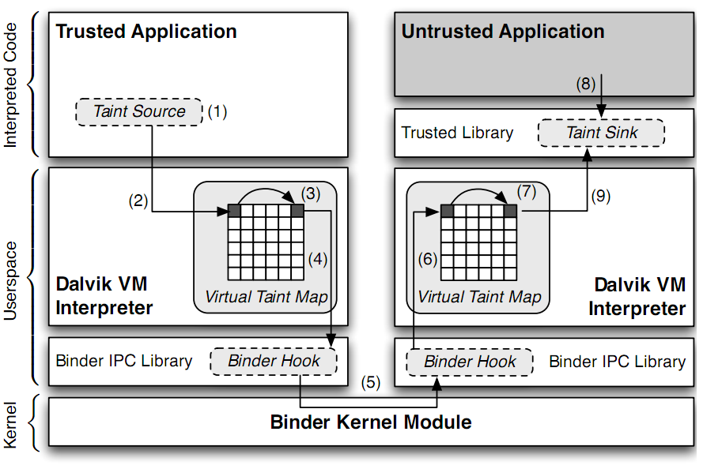
TaintDroid Architecture
Notes:
Sensitive information is ﬁrst identiﬁed at a taint source, where a taint marking indicating the information type is assigned. Dynamic taint
analysis tracks how labeled data impacts other data in a way that might leak the original sensitive information.
Finally, the impacted data is identiﬁed before it leaves the system at a taint sink (usually the network interface).
possible false positive

Slide 39
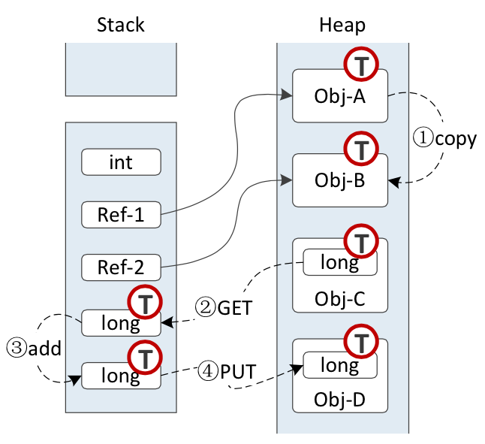
Four Types of Tainting
From heap to heap
From heap to stack
From stack to stack
From stack to heap
Notes:
1. fromheaptoheap(1infig4-aand1infig4-b),
2. from heap to stack (2 in fig 4-b),
3. from stack to stack (3 in fig 4-b), and
4. from stack to heap (4 in fig 4-b).

Slide 40
Heap to Stack
A property of Java: all operations must be done through the stack
  E.g., "A.a = B.b" will be compiled to:
    GET "A.a" to the stack
    PUT the value to "B.b"

Slide 41
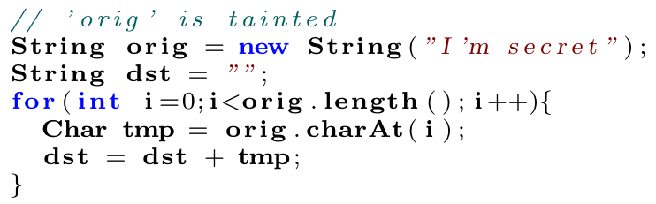
Heap to Stack
String orig is tainted
  On heap: orig and dst
  On stack: tmp
Heap to stack
  The tainted object generates a primitive type, whose taint tag will propagated to the stack variable
Stack to heap
  The taint tag will also propagate to the heap

Slide 42
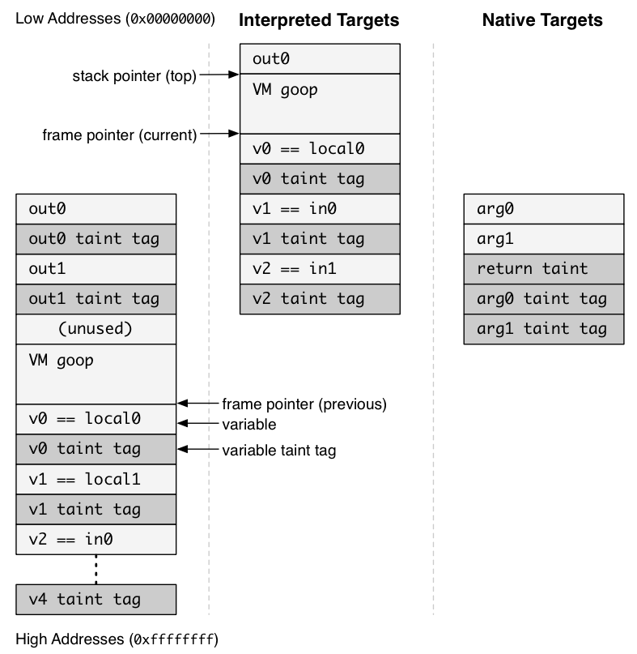
TaintDroid Design
When App is invoked, a new stack frame is allocated
Registers (variables) are placed on the stack
Stack frame are twice as big for taint tags

Slide 43
TaintDroid Design
Variable Level Tracking
  Primary Tracking Method
    Propagation Rules are key
  Only save one tag for an array, e.g., String
    Better performance, but may cause false positive

Slide 44
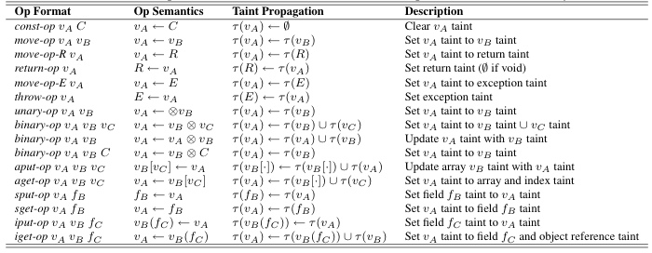
Taint Propagation

Slide 45
TaintDroid Design
Internal VM methods
  Relatively small number of such methods (5 in 185)
  Manually inspected and patched to propagate
JNI methods
  Patch the call bridge to provide
  When a JNI returns, consults a method profile table for tag propagation updates

Slide 46
TaintDroid Design
Message Level Tracking
  Binder IPC mechanism (centralized location)
  Entire message is labeled instead of variables
    Trade off between performance and accuracy
File Level Tracking
  Taint label stored in the extended file attribute
  Entire file is labeled
    Again, trade off between performance and accuracy
  Taint label propagated to variables on access

Slide 47
TaintDroid Design
Identifying Privacy Data
Each source must be studied carefully
  False Positives if wrong source is tainted
  False Negative if a source is missed

Slide 48
TaintDroid Design: Sources
Low-bandwidth Sensors
  Variety of privacy data obtain from these sensors
    Ex: Location, and Accelerometer
  Changes frequently, and used by many applications
  Most smartphone OS have some type of manager to multiplex this information
  Android privacy hook (labels) in LocationManager and SensorManager Applications

Slide 49
TaintDroid Design: Sources
High-bandwidth Sensors
  Include privacy information such Microphones and Cameras
  Returns a large amount of data and is only used by one application at time
    Sensor information is propagated through large data buffers and/or files
    Hooks placed in these data buffers and files

Slide 50
TaintDroid Design: Sources
Information Databases
  Contact and SMS (Text) Messages are often stored in file based databases
  Taint Tags place on these files
Device Identifiers
  Information that Identifies the phone or user
    Ex SIM card identifiers
  Some are access through well defined APIs
  APIs are hooked

Slide 51
TaintDroid Design: Sink
Network Taint Sink
  When data is transmitted out of the network interface
  Taint is place in VM Interpreter
  Label read when the socket library is invoked
Summary
  Privacy data is labeled (tainted)
  Propagates up and down the architecture.
  These labels are read and thus…

Slide 52
Contributions
TaintDroid produced useful results for every application tested
A useful privacy analysis tool was implemented
  produced no false positives in experiments completed
  high performance in design
  also, released to public

Slide 53
Experimental Results
Observed Behavior (# of apps) | Details
Phone Information to Content Servers (2) | 2 apps sent out the phone number IMSI, and ICC-ID along with geo-coordinates to the app’s content server
Device ID to Content Servers (7)* | 2 social, 1 shopping, 1 reference and 3 other apps transmitted the IMEI number to the app’s content server
Location to Advertisement Servers (15) | 5 apps sent geo-coordinates to ad.qwapi.com, 5 apps to admob.com, 2 apps to ads.mobclix.com (1 sent location both to admob.com and ads.mobclix.com) and 4 apps sent location to data.flurry.com
Notes:
Enck et al. found that 20 out of 30 applications had potential privacy violations. 3 applications had multiple violations. *9 applications were flagged by TaintDroid in this category, but 2 of them actually mentioned their data usage in their EULAs.

Slide 54
Experimental Results
TaintDroid produced no false positives on the application set tested
1/2 of applications shared location data with advertising servers
~1/3 expose device ID
Authors claim no perceived latency in using interactive applications
TaintDroid shown to be qualitatively useful
Notes:
Author’s claim: Their claim is probably legitimate. They made the case that (1) most applications are primarily in a "wait" state and (2) heavyweight operations such as screen updates are not monitored by TaintDroid

Slide 55
Weaknesses
Mentioned by Enck et al.:
  TaintDroid can be circumvented by implicit information flow
  TaintDroid cannot tell if tainted information re-enters the phone after leaving
Interactive application latency was reported anecdotally, but could have been measured more formally
Notes:
TaintDroid can: Detecting this requires static code analysis, which is not necessarily an option for closed-source Play Store applications

Slide 56
Evading Tainting
if (x == 0) y = 0;
else if (x == 1) y = 1;
...
else if (x == 255) y = 255;
Windows 2000 kernel illustrates this problem when translating keyboard scancodes into unicode

Slide 57
Evading Tainting
Using side-channel attacks
  Any global resource that can be used to transfer 0/1
  Timing attack
  Usually transfer one bit at a time
    But the sensitive data is also small at most time…

Slide 58
Weaknesses
Needs a bigger sample size for statistics
Taint tags are added manually
Taint tags memory location is predictable

Slide 59
Improvement
Use the tool to test a larger sample size
Develop component to automate the tagging process
Randomized the taint tag memory location, or prevent it from being modified

Slide 60
Taxi
Taxi: Defeating Code Reuse Attacks with Tagged Memory

Slide 61
Goals
Defend code reuse attacks
  With tagged memory
  A small set of hardware modifications

Slide 62
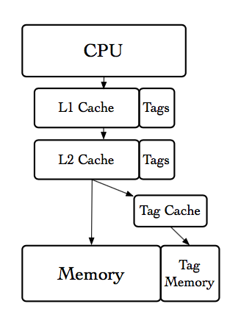
Tagged Memory of Taxi
Each words has a tag
  64-bit word + 8-bit tag
Tags are located separately from data

Slide 63
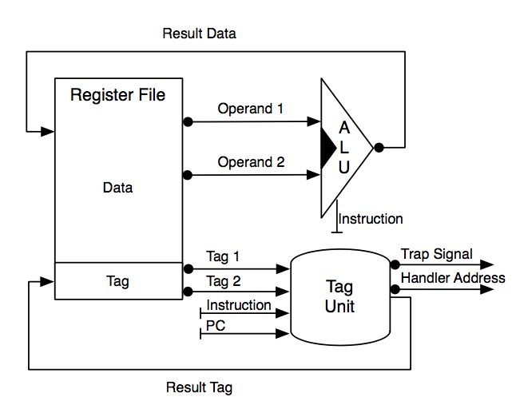
Tag Propagation
Tag processing unit (TPU)
  Parallel computation of ALU
  Calculate result tag
TPU generates a trap for
unexpected input

Slide 64
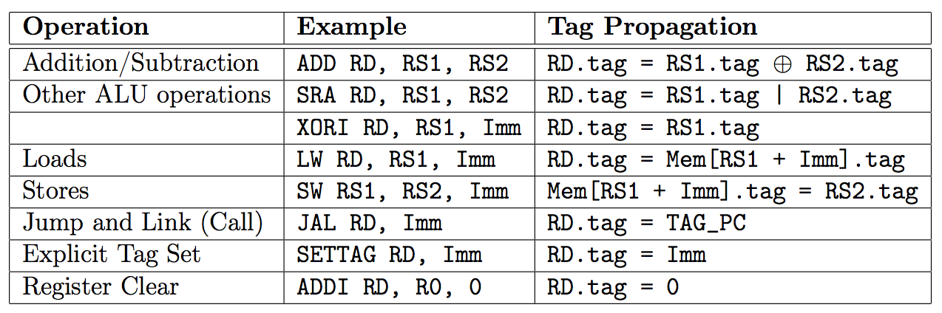
Tag Propagation

Slide 65
TAXI
Call/Return Discipline Protection
  Return can only return to the address pushed by call
Return Address
RET
&system()
RET
Frame Pointer
DATA
e
DATA
Buf[3]
DATA
d
DATA
Buf[2]
DATA
c
DATA
Buf[1]
DATA
Gets()
b
DATA
Stack Pointer
Buf[0]
DATA
a
DATA

Slide 66
TAXI
Call/Return Discipline Protection
  Return can only return to the address pushed by call
Wrong Tag!
Return Address
RET
&system()
DATA
Frame Pointer
DATA
e
DATA
Buf[3]
DATA
d
DATA
Buf[2]
DATA
c
DATA
Buf[1]
DATA
Gets()
b
DATA
Stack Pointer
Buf[0]
DATA
a
DATA

Slide 67
Replay Attack
Old return addresses are not cleaned
Attacker can "replay" existing return addresses
Current
Return Address
RET
Current
Frame Pointer
DATA
Stack Pointer
x
DATA
Old
Return Address
RET
Old
Frame Pointer
DATA
y
DATA

Slide 68
Replay Attack
Old return addresses are not cleaned
Attacker can "replay" existing return addresses
Old
Return Address
RET
Current
Frame Pointer
DATA
Stack Pointer
x
DATA
Old
Return Address
RET
Old
Frame Pointer
DATA
y
DATA

Slide 69
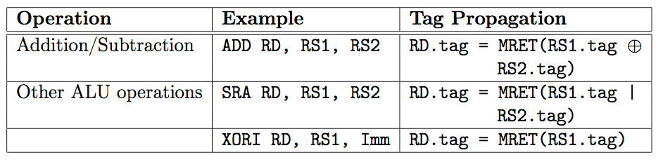
Linearity
Only one copy of all return addresses created by call instructions can be used by a return instruction at a time
Remove the return tag after a return address is copied to a register/memory.

Slide 70
Linearity
Old return addresses are not cleaned
Attacker can "replay" existing return addresses
Old
Return Address
RET
Old
Return Address
DATA
Current
Frame Pointer
DATA
Current
Frame Pointer
DATA
Stack Pointer
x
DATA
Stack Pointer
x
DATA
Old
Return Address
RET
Old
Return Address
RET
Old
Frame Pointer
DATA
Old
Frame Pointer
DATA
y
DATA
y
DATA

Slide 71
PUMP
Architectural Support for Software-Defined Metadata Processing, ASPLOS'15

Slide 72
Goals
User-defined metadata processing
  Arbitrary metadata size
  Arbitrary policy
    CFI + IFC (Information Flow Control) + DFI + …
  With low overhead
    Performance overhead and hardware resources overhead

Slide 73
Overview of PUMP
PUMP: Programmable Unit for Metadata Processing
  An extension to a conventional RISC processor
  Pointer-size metadata tag for each word
  Propagation tag on each instruction

Slide 74
Metadata Tag
Each word has a pointer-sized tag
  Small tag directly stored
  Large tag stored indirectly in memory
Tagged memory, cache, register, PC,…
Tag cannot be addressable
  Only updated by PUMP rules

Slide 75
PUMP Rule
Define tag-propagation policy
opcode : (PC, CI, OP₁, OP₂, MR) -> (PC_{new}, R)/Fail
  opcode : opcode of current instruction
  PC : tag of PC
  CI : tag of current instruction
  OP₁/OP₂: tag of operator (register)
  MR: tag of value read from memory
  PC_{new} : update tag of PC
  R : update tag of result

Slide 76
PUMP Rule - CFI
return: (empty, -, -, -, -) -> (check, -)
$\overline{return}$: (check, tgt, -, -, -) -> (empty, -)
$\overline{return}$: (empty, -, -, -, -) -> (empty, -)
return: (check, tgt, -, -, -) -> (check, -)

Slide 77
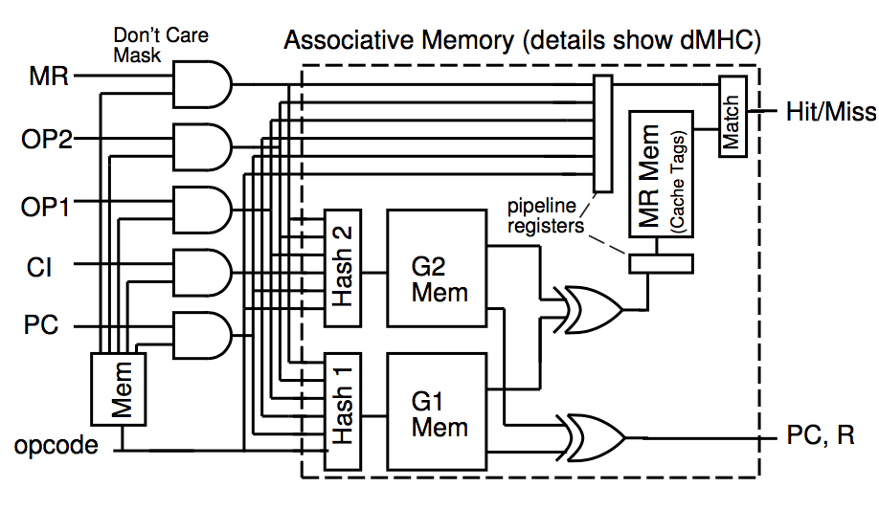
Rule Cache
Provide single-cycle common-case computation on metadata
A hardware-cache for most recently used rules
  Cache-hit does not add extra cycle
Associative mapping
  Opcode and 5 input tags
  2 output tags
  Compare tag-pointer
  Failure cases are not cached

Slide 78
Miss Handler
Save current opcode and tags in new registers
Transfer control to handler running in a special mode
Miss handler decides if the operation is allowed
  Yes, generates an rule, when return
  No, invokes a suitable security fault handler
Miss handler installs this rule into caches and re-issues the faulting instruction
  Miss-handler-return instruction

Slide 79
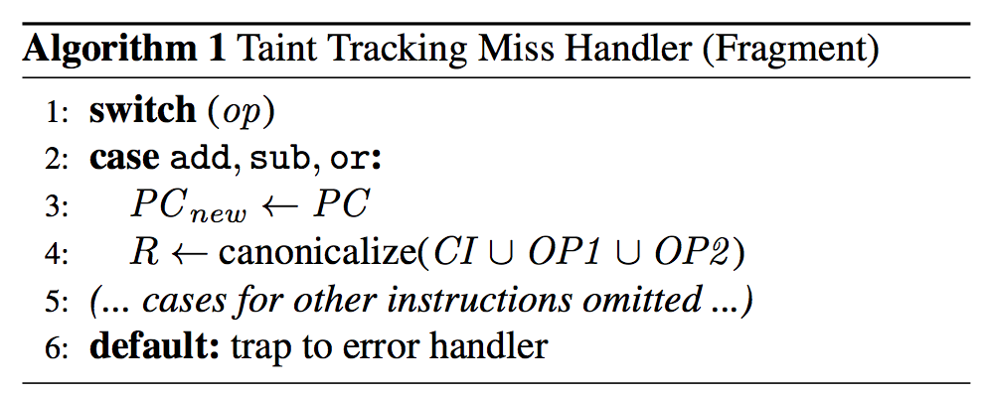
Miss Handler

Slide 80
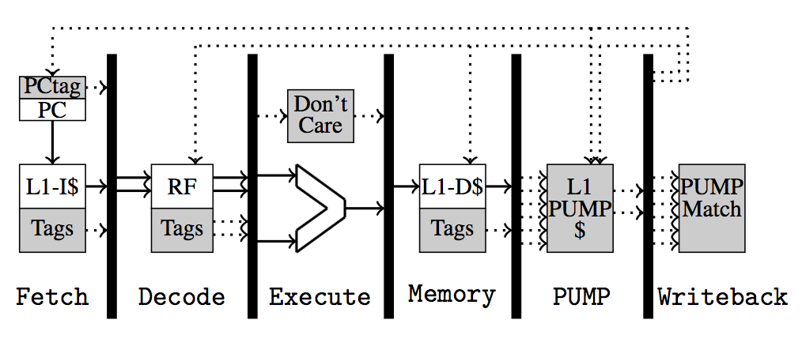
Pipeline Integration

Slide 81
Design Problem
Large memory costs
  +190% memory area overhead
Performance overhead
  Fast single policy (average 10%)
  Slow composite policy (worst case 780%）
Energy overhead
  400% for single policies (worst case)
  1600% for the Composite policy (worst case)

Slide 82
Bound Checking

Slide 83
Bounds Checking
Tracking bounds information
Check bounds before memory accesses
Challenges
  How to record the bounds information
  How to efficiently check bounds

Slide 84
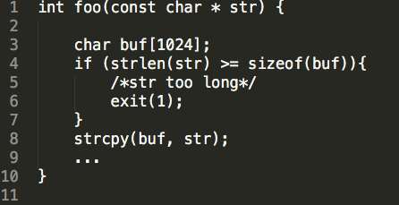
Bounds Checking

Slide 85
Address Sanitizer
AddressSanitizer: A Fast Address Sanity Checker (USENIX ATC'12)

Slide 86
Overview
Compile-time instrumentation module
  LLVM, platform independent
  ~1 KLOC
Run-time library
  Supports Linux, MacOS, Android
  ~9 KLOC
Released in May 2011
Part of LLVM since November 2011

Slide 87
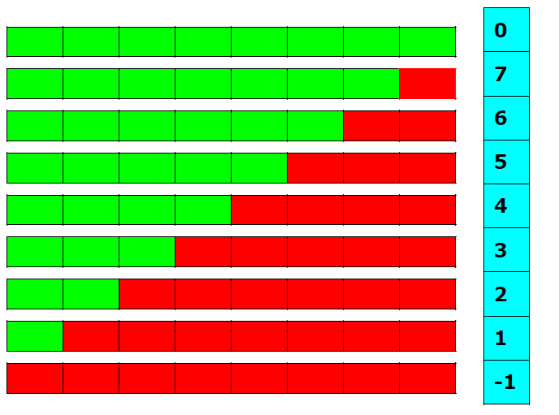
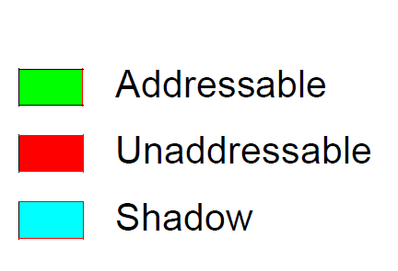
Design
Shadow Byte
Notes:
Every aligned 8-byte word of memory has only 9 states
- First N bytes are addressable, the rest 8-N bytes are not
- Can encode in 1 byte (shadow byte)

Slide 88
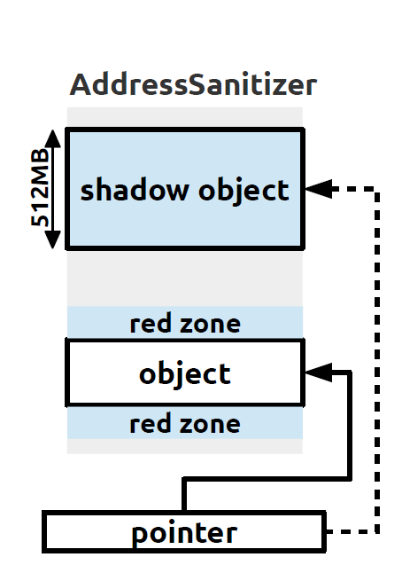
Design
1/8 of the memory are use to save the shadow object.

Slide 90
Instrumentation: 8 bytes access
*a = ...
char *shadow = (a>>3)+Offset;
if (*shadow)
ReportError(a);
*a = ...

Slide 91
Instrumentation: N bytes access(N=1,2,4)
*a = ...
char *shadow = (a>>3)+Offset;
if (*shadow && *shadow <= ((a&7)+N-1))
ReportError(a);
*a = ...

Slide 92
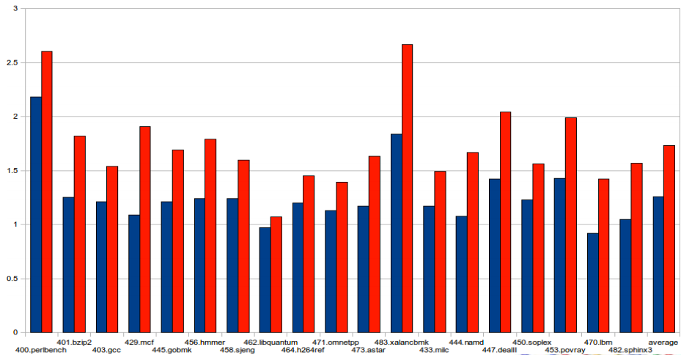
Performance Evaluation
1.73x slowdown (reads & writes) 1.26x slowdown (writes only)

